Slide 1
Simulations PSF Matlab
Andrey ARISTOV
2015-04-08 -- 20

Slide 2
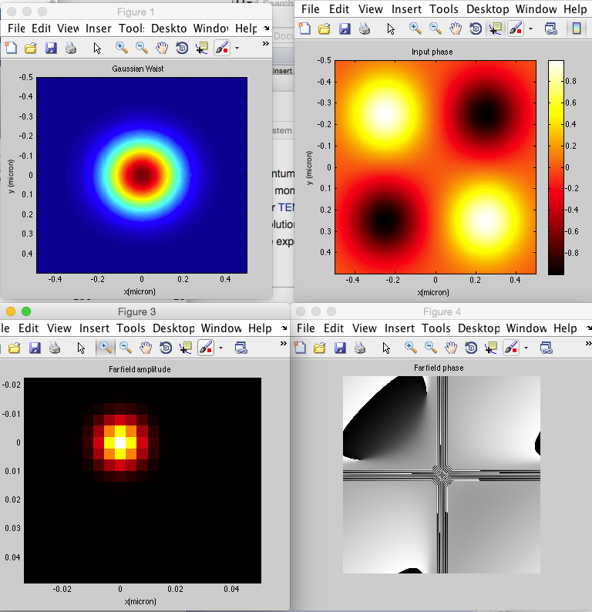
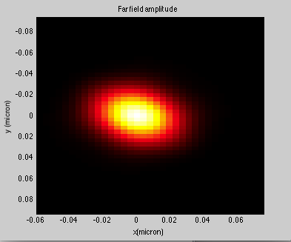
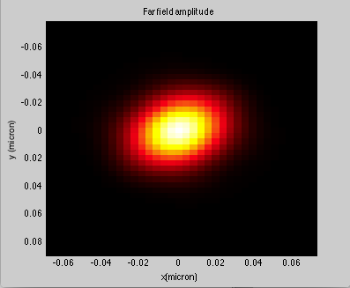
Saddle-point
%Saddle-point phase profile:
% 4 gaussian peaks approx
we1 = 2^(-3);
xc1 = 2^(-2);
yc1 = 2^(-2);
xc2 = -2^(-2);
yc2 = 2^(-2);
xc3 = 2^(-2);
yc3 = -2^(-2);
xc4 = -2^(-2);
yc4 = -2^(-2);
%xc1 = 0;
%yc1 = 0;
sp(i,j) = exp((-(x(i)-xc1)^2-(y(j)-yc1)^2)/(we1)^2/2) - exp((-(x(i)-xc2)^2-(y(j)-yc2)^2)/(we1)^2/2) - exp((-(x(i)-xc3)^2-(y(j)-yc3)^2)/(we1)^2/2) + exp((-(x(i)-xc4)^2-(y(j)-yc4)^2)/(we1)^2/2);

Slide 3
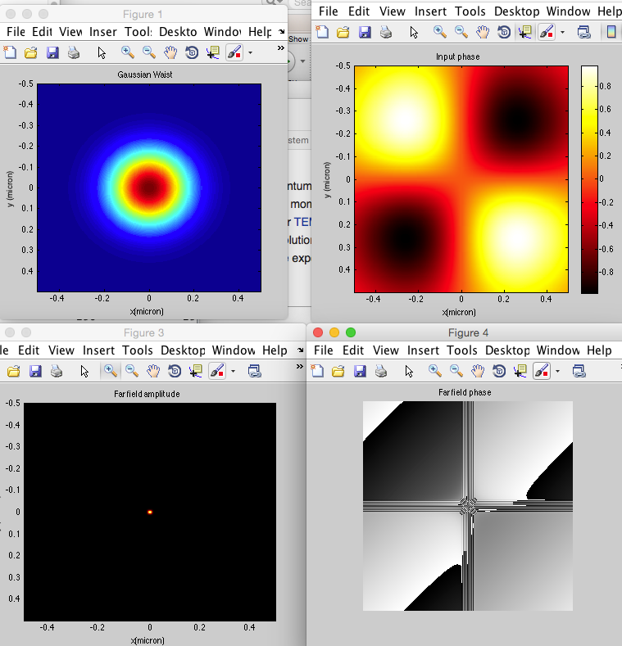
Pi*sp
Xc 2e-2 -> 2e-3

Slide 4
New calculation
Put the point source into the focal plane
Get the fourier image
Truncate it by circle
Add phase mask
Get the camera image

Slide 5
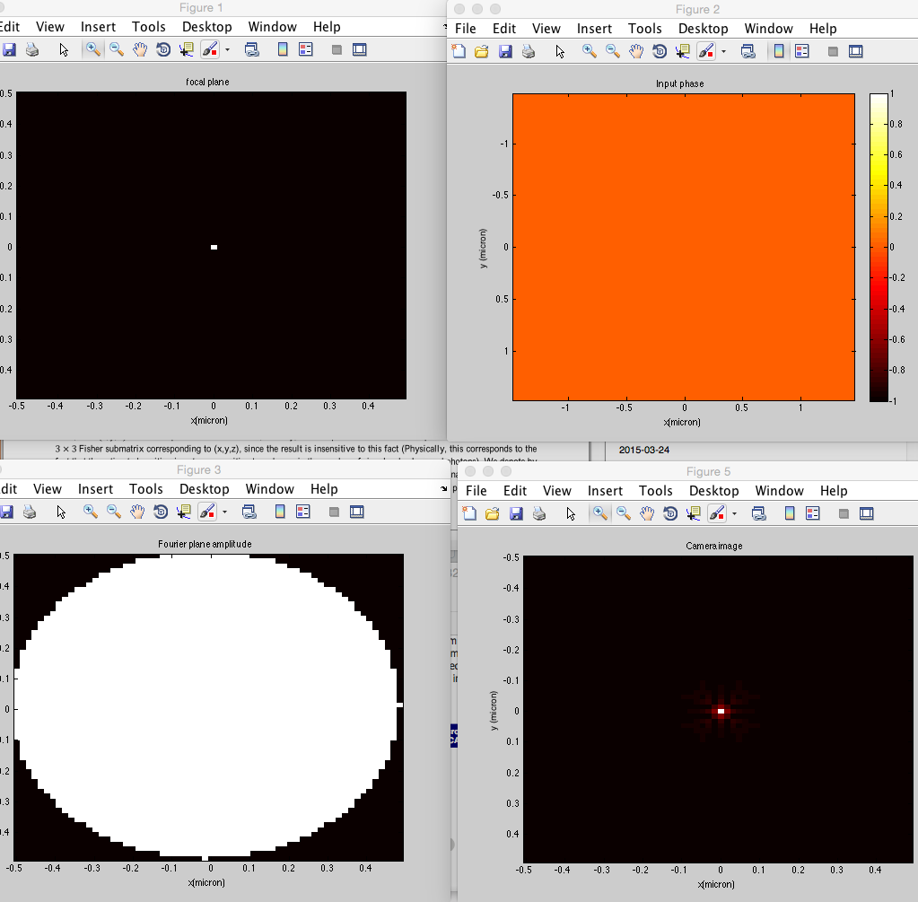
No phase mask

Slide 6
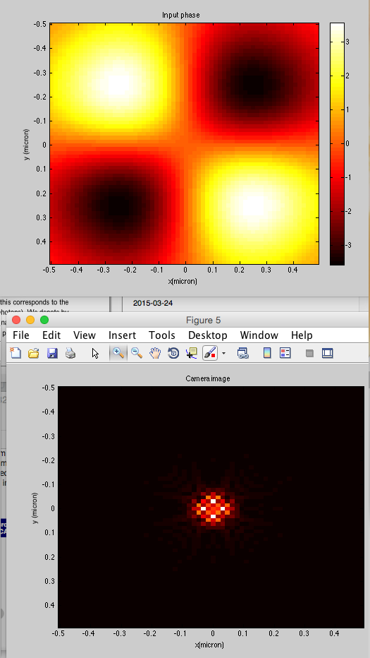
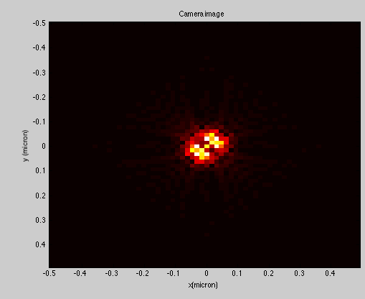
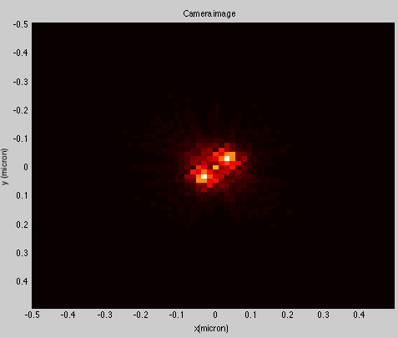
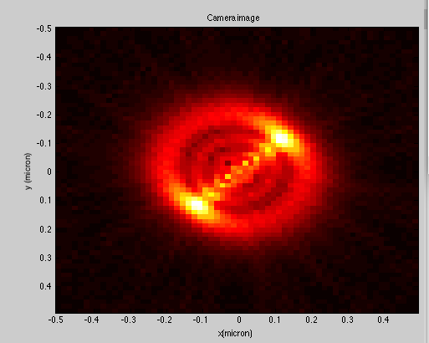
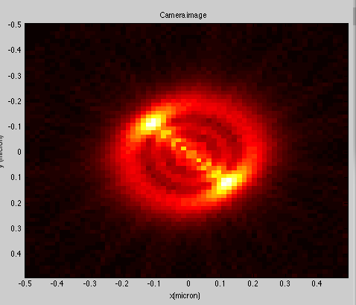
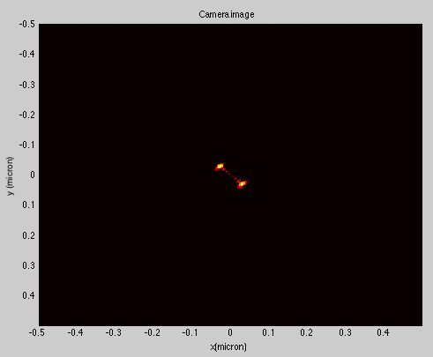
Saddle point (simulated by 4 Gaussian spots) out of focus PSF
Amplitude threshold
Strong background

Slide 7
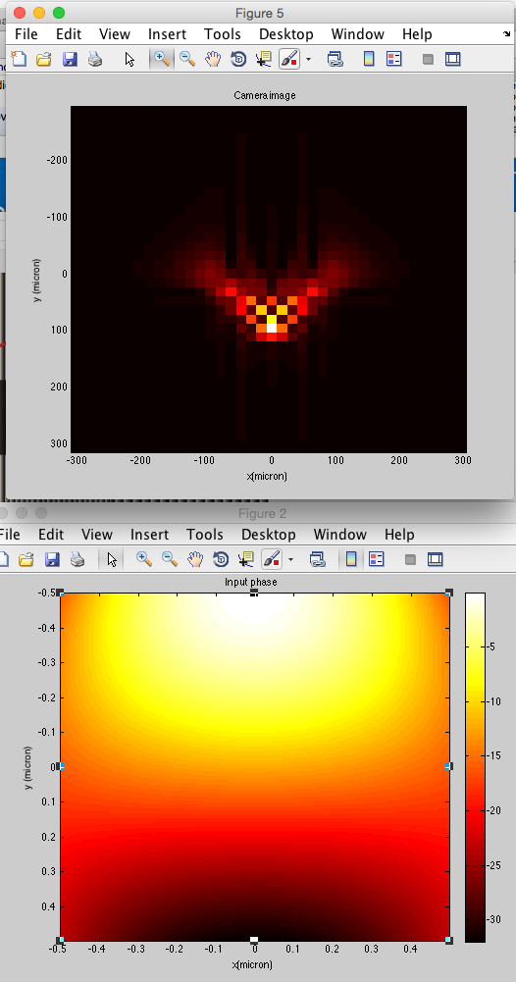
Airy beam (Jia NP 2014)
Using the formula from the paper I got these far field and phase profiles

Slide 8
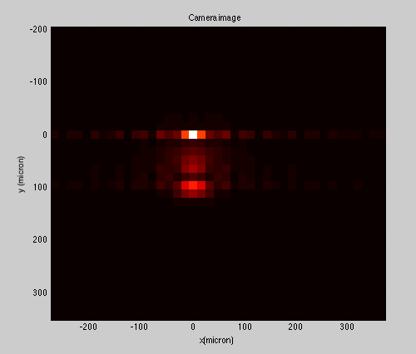
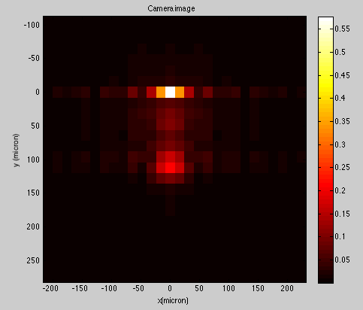
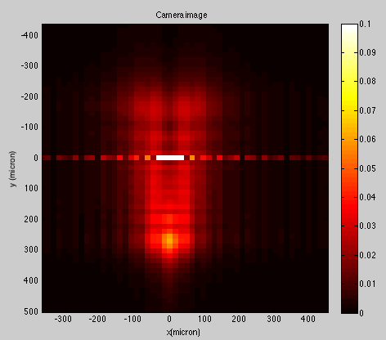
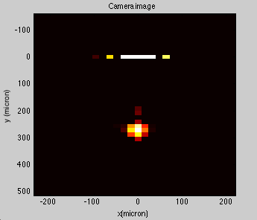
Airy beam (Jia NP 2014)
Phase truncate
One can see the zero order at the 0,0 and diffracted order lower down

Slide 9
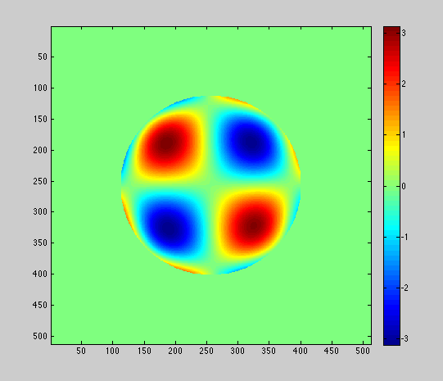
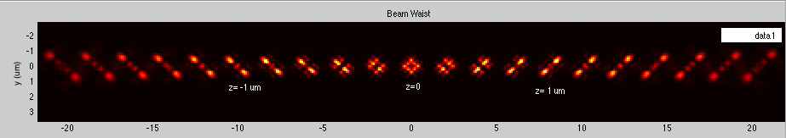
Saddle-point phase mask from Yoav Shechtman
Z=-2 : 0.2 :2 um

Slide 10
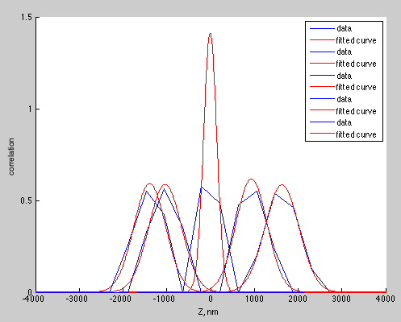
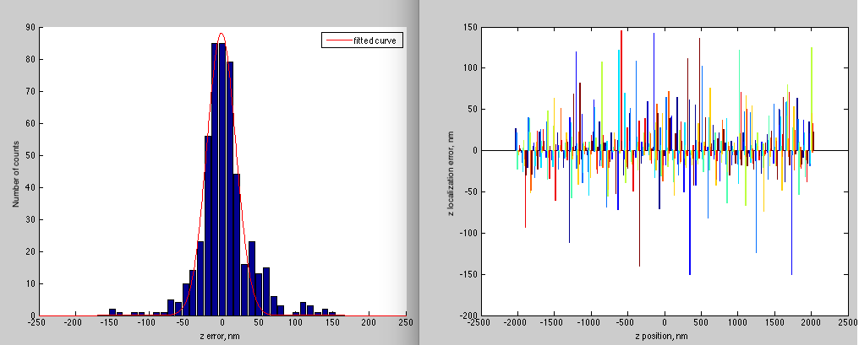
Ideal Saddle-point z search
20 PSF library
8 um range
Random z test psf
4 um range
27 nm width

Slide 11
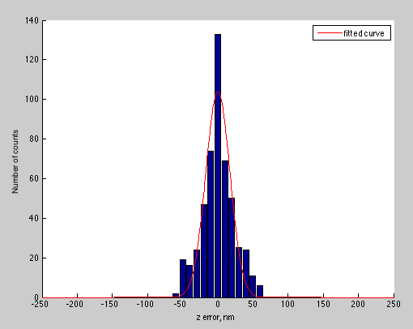
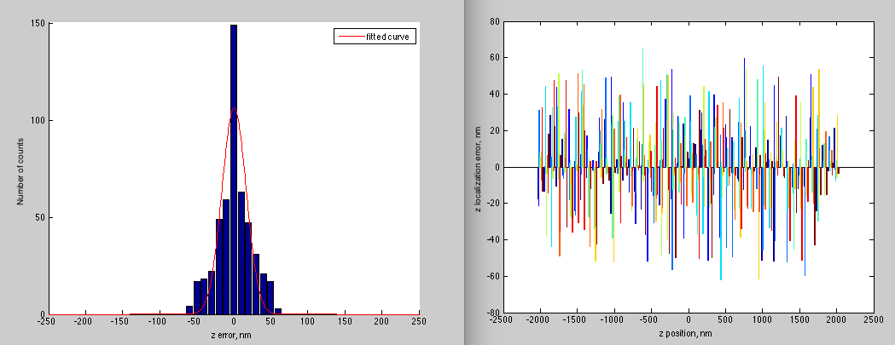
Ideal Saddle-point z search
50 PSF library
8 um range
Random z test psf
4 um range
24 nm width

Slide 12
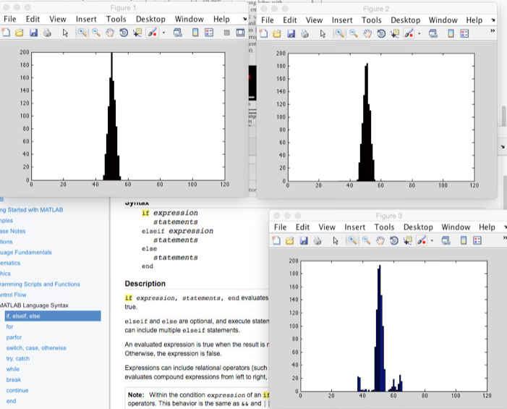
3D localization

Slide 13
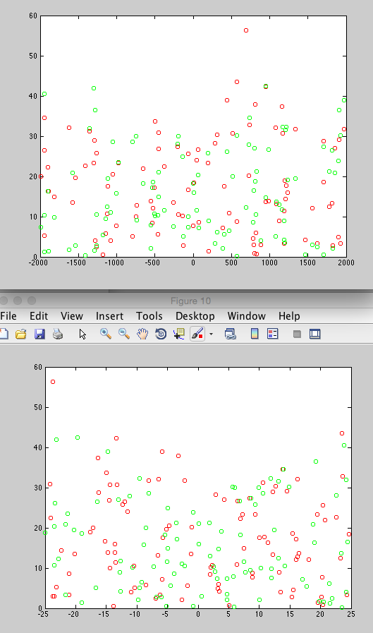
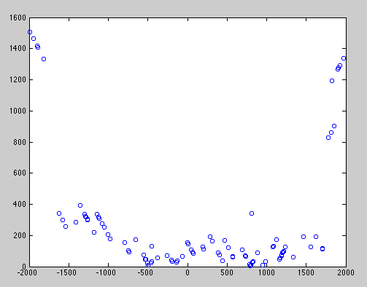
Errorstats
X,y err vs z
Zerr vs zp
X,y err vs x,y
The errors on |z|>1,6 um are due to wrong
correlation values. The PSF become very spread and
the smaller Z from biblioteque gives higher xcorr values.

Slide 14
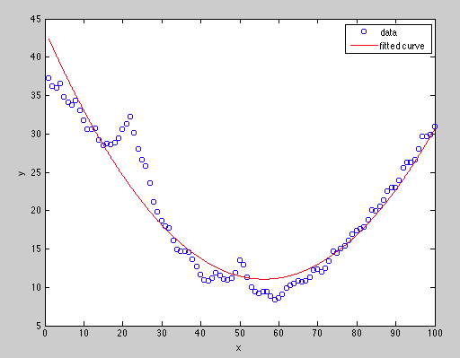
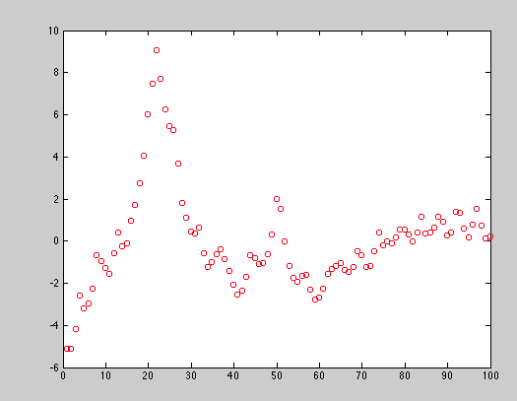
Xcorr search optimizations
So now I
normalize the camera image frame
Use normalized PSF library
Subtract the second order curve xcorr(z)
The example of xcorr2(z), z= –3 : 3 um
Library z = –4 : 4 um, 80 nm steps
Optimized curve after subtraction

Slide 15
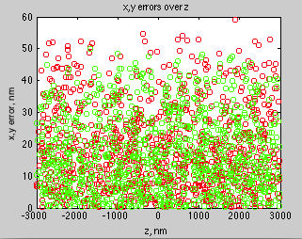
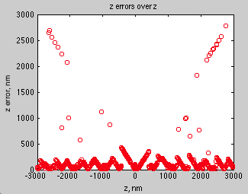
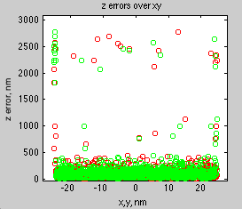
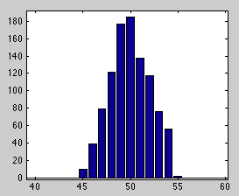
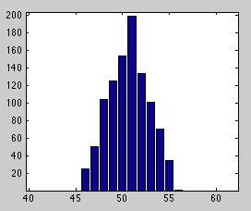
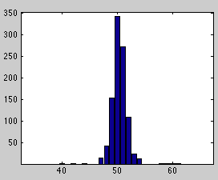
Error stats
ˆx 50 nm FWHM (100 nm discretisation step)
y – 60 nm
Z – 150 nm

Slide 16
Need of M(z) statistics
The system is messed up about zero due to the persistent peak
Too many z points to search
Better to 2 step search!

Slide 17
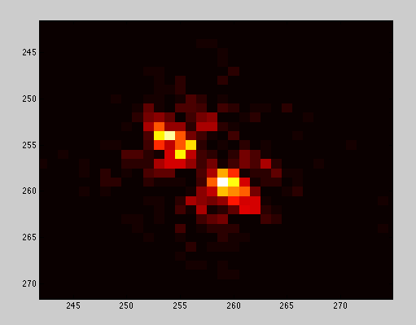
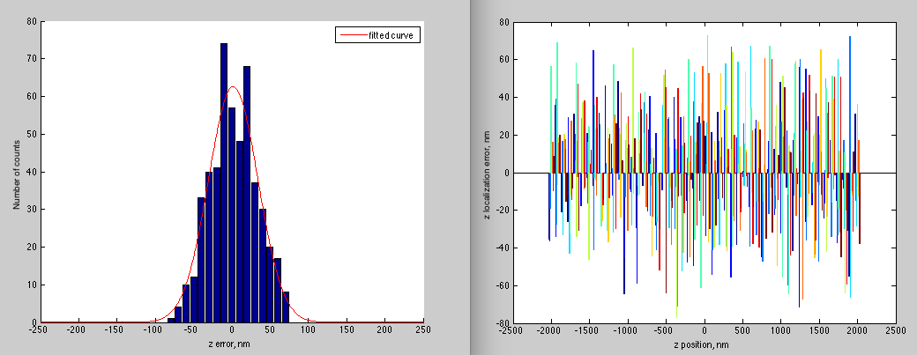
Noisy Saddle-point z search
50 PSF library
8 um range
Random z test psf
1000 photons
4 um range
45 nm width

Slide 18
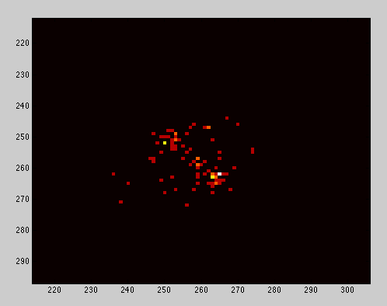
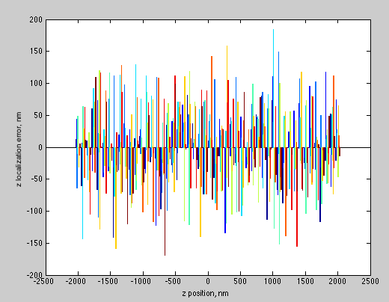
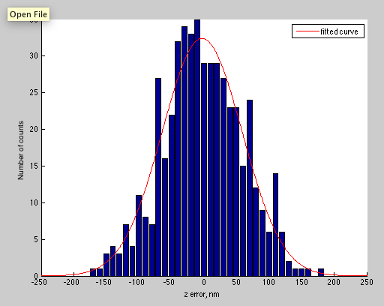
Noisy Saddle-point z search
50 PSF library
8 um range
Random z test psf
100 photons
4 um range
87 nm width

Slide 19
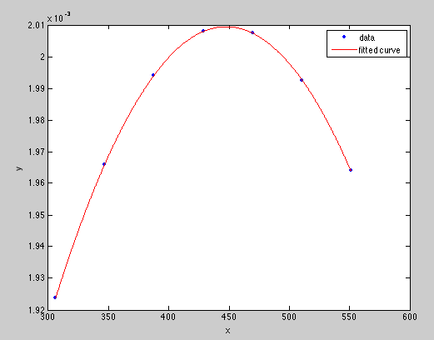
Precise z-position search
7 points in proximity of Mmax to fit poly2

Slide 20
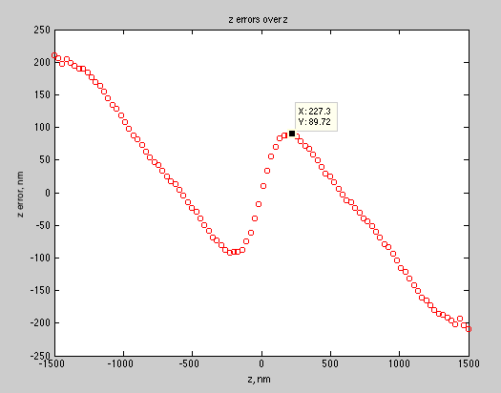
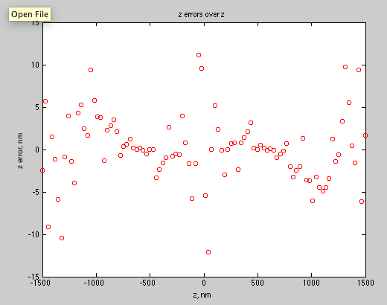
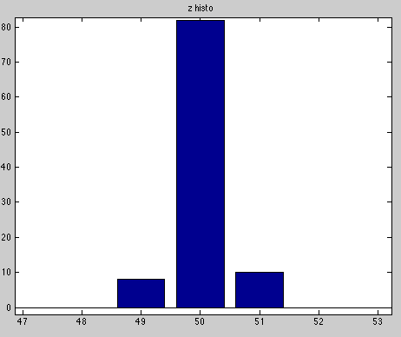
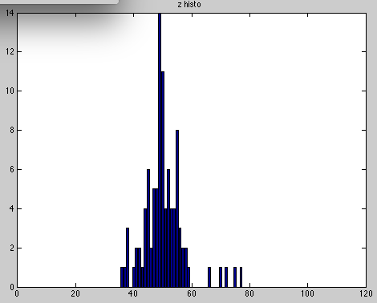
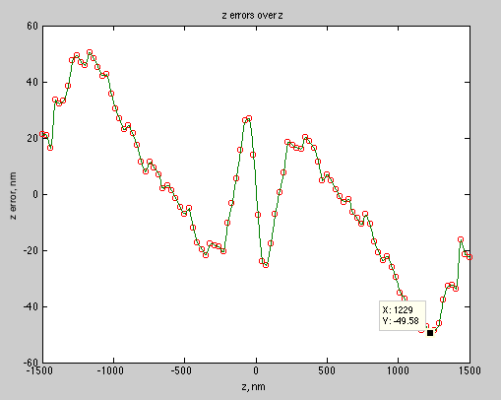
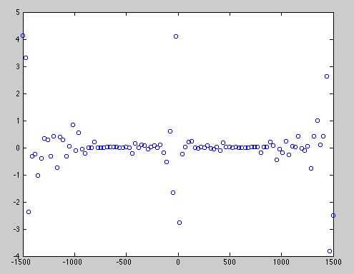
Correction z table
Using spline to correct for errors
Second correction
First correction
FWHM 7 nm

Slide 21
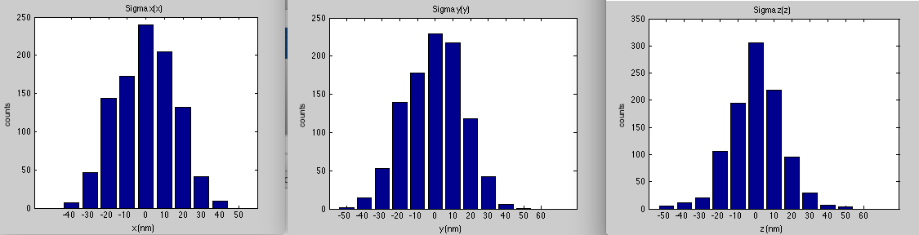
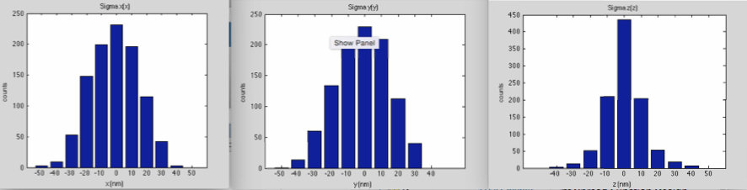
Fitting noisy data
1000 frames 3000 photons (10 nm step histo)

Slide 22
Fitting noisy data
1000 frames 3000 photons (10 nm step histo)

Slide 23
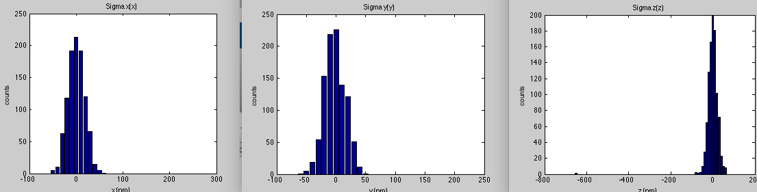
Fitting noisy data
1000 frames 1000 photons (10 nm step histo)

Slide 24
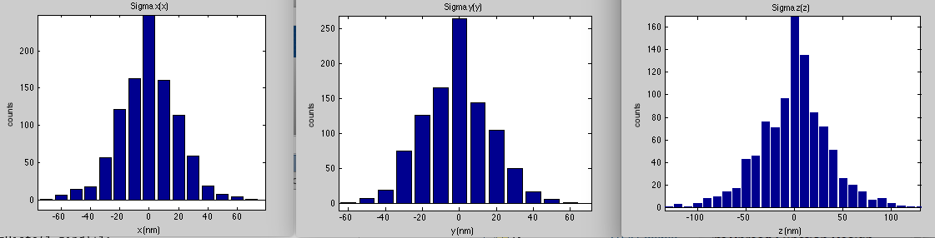
Fitting noisy data
1000 frames 300 photons (10 nm step histo)

Slide 25
Fitting noisy data
1000 frames 300 photons (10 nm step histo)

Slide 26
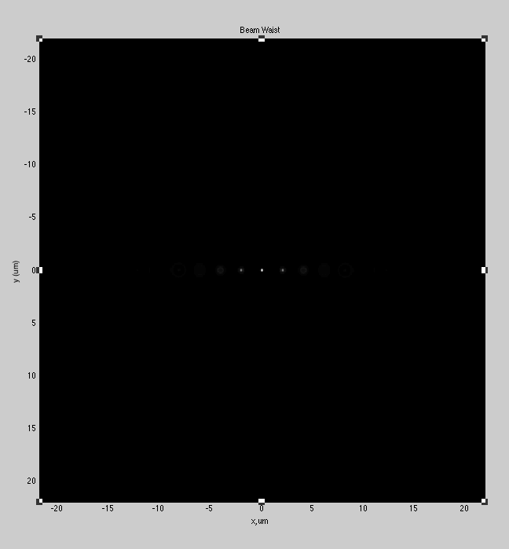
Gauss
Z=-2 : 0.1 :2 um

Slide 27


Astigmatism
fc=50
Z=-2 : 0.1 :2 um
Fc=200

Slide 28


Double-helix phase mask (Grover 2011)
Z= -2 : 0.2 : 2 um

Slide 29



Airy beam
Normal
alignement
Imaging lens
Out of axis
Z= 0 : 0.05 : 2 um

Slide 30


Truncated Airy phase

Slide 31



Airy 10 sin(i) outside 50 sin(i)
0-2 um, 0.1 um step

